Slide 1
Dynamic Operating Envelopes
Athul Jose P
11867566

Slide 2
Introduction
Increased renewable installation at distribution level
Opportunity to participating in markets
To prevent network violations – curtail generation
Unutilized installed capacity of DERs
Operating Envelopes
Dynamic Operating Envelopes

Slide 3
Dynamic Operating Envelope
Operating envelopes are the limits that an electricity customer can import and export to the electricity grid
Dynamic Operating Envelopes(DOEs) are where import and export limits can vary over time and location.
DOEs could be used to manage ’flexible loads’ such as water heaters, battery storage and electric vehicles (EVs)
Benefits
1. More solar / battery support 2. Market Efficiency 3. Greater Interoperability 4. Network Efficiency
DEIP, “Dynamic operting envelopes working group outcomes report,” DEIP, Tech. Rep., 2022.

Slide 4
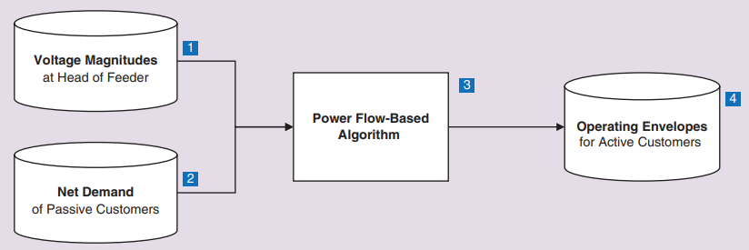
Calculating Operating Envelope
M. Z. Liu, L. N. Ochoa, S. Riaz, P. Mancarella, T. Ting, J. San, and J. Theunissen, “Grid and market services from the edge: Using operating envelopes to unlock network-aware bottom-up flexibility,” IEEE Power and Energy Magazine, vol. 19, no. 4, pp. 52–62, 2021.

Slide 5
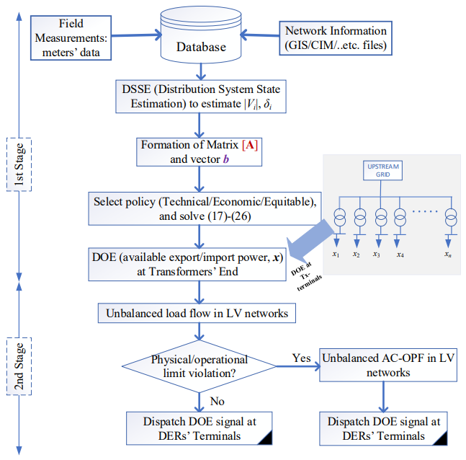
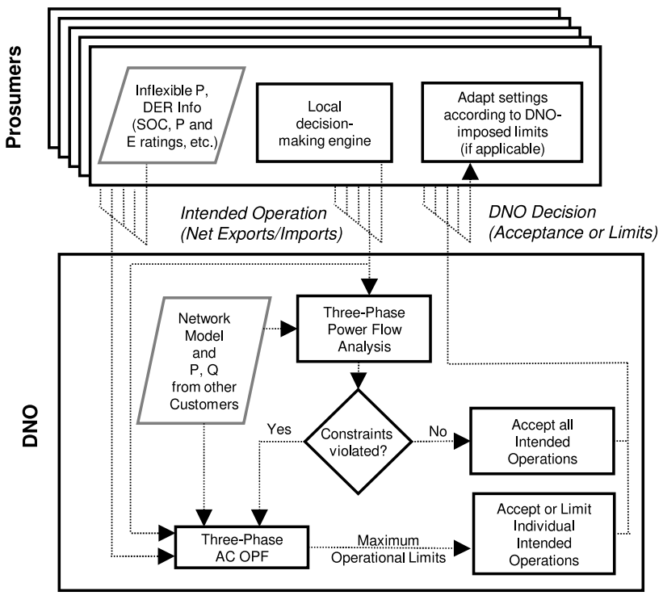
Allocation of DOE
K. Petrou, A. T. Procopiou, L. Gutierrez-Lagos, M. Z. Liu, L. F. Ochoa, T. Langstaff, and J. M. Theunissen, “Ensuring distribution network integrity using dynamic operating limits for prosumers,” IEEE Transactions on Smart Grid, vol. 12, no. 5, pp. 3877–3888, 2021
M. Alam, P. T. Nguyen, L. Naranpanawe, T. K. Saha, and G. Lankeshwara, “Allocation of dynamic operating envelopes in distribution networks: Technical and equitable perspectives,” IEEE Transactions on Sustainable Energy, 2023.

Slide 6
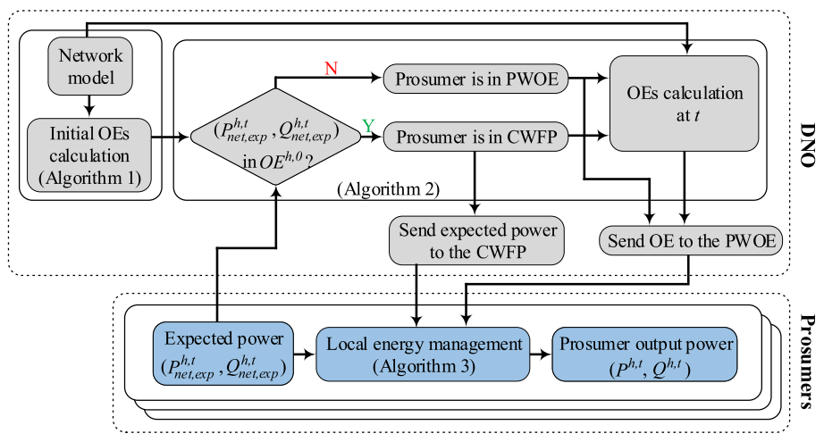
DOE Control Framework
Y. Z. Gerdroodbari, M. Khorasany, and R. Razzaghi, “Dynamic pq operating envelopes for prosumers in distribution networks,” Applied Energy, vol. 325, p. 119757, 2022.

Slide 7
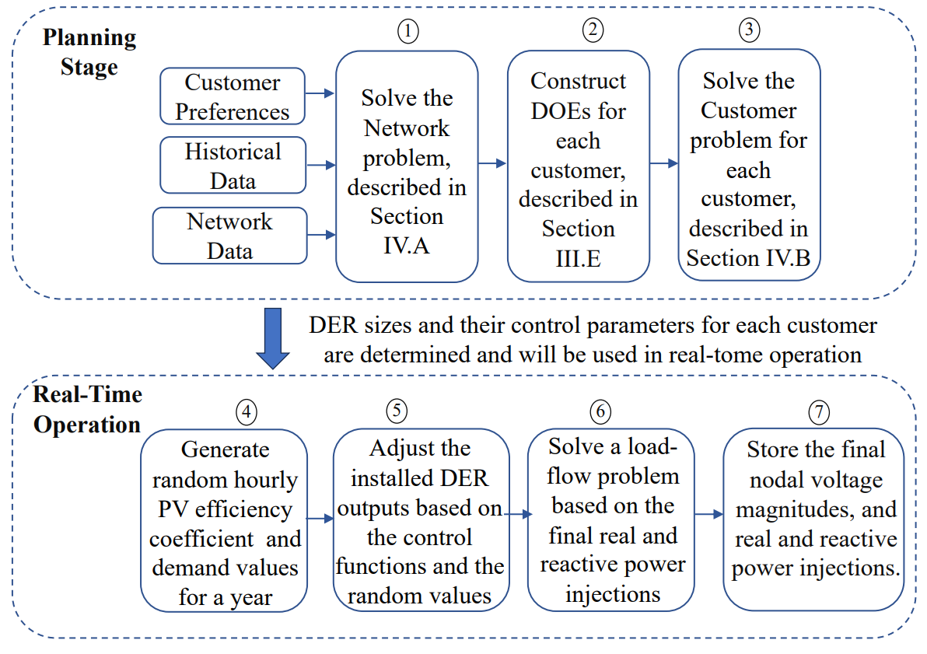
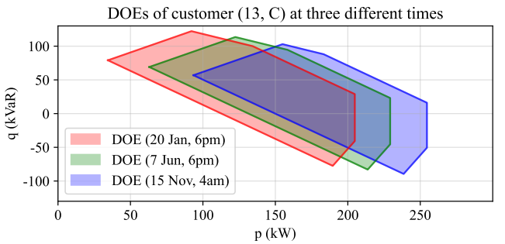
DOE with Decomposition Method
M. Mahmoodi, L. Blackhall, S. M. N. RA, A. Attarha, B. Weise, and A. Bhardwaj, “Der capacity assessment of active distribution systems using dynamic operating envelopes,” IEEE Transactions on Smart Grid, 2023

Slide 8
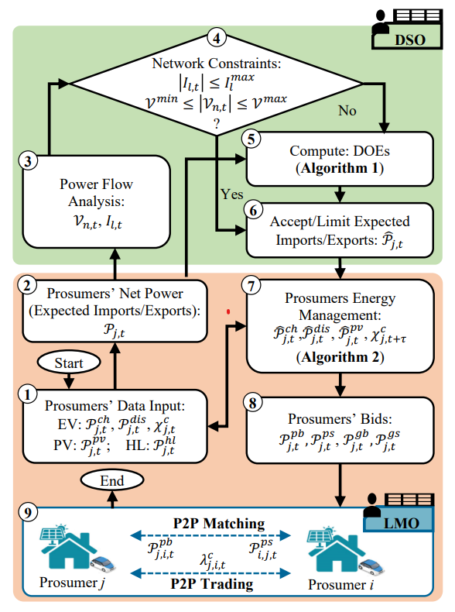
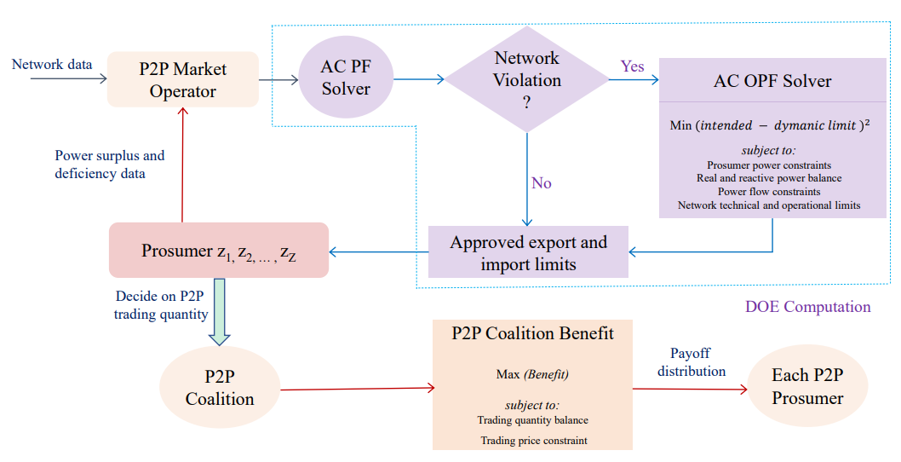
DOE based Market for Prosumers
M. I. Azim, G. Lankeshwara, W. Tushar, R. Sharma, M. R. Alam, T. K. Saha, M. Khorasany, and R. Razzaghi, “Dynamic operating envelope-enabled p2p trading to maximise financial returns of prosumers,” IEEE Transactions on Smart Grid, 2023
M. M. Hoque, M. Khorasany, M. I. Azim, R. Razzaghi, and M. Jalili, “Dynamic operating envelope-based local energy market for prosumers with electric vehicles,” IEEE Transactions on Smart Grid, 2023

Slide 9
Summary
DOEs are used for greater network efficiency and more market operation of DERs
Main component of DOE is checking the network violations from power flow
DOEs can be used with prosumers for electricity markets and shown to be efficient

Slide 10



